Slide 1
Create a Bug in TFS
Halliburton-Knoesis

Slide 2
Agenda
1. Steps to create a bug in TFS
2. Step to get Knoesis log
3. Check list for a bug

Slide 3
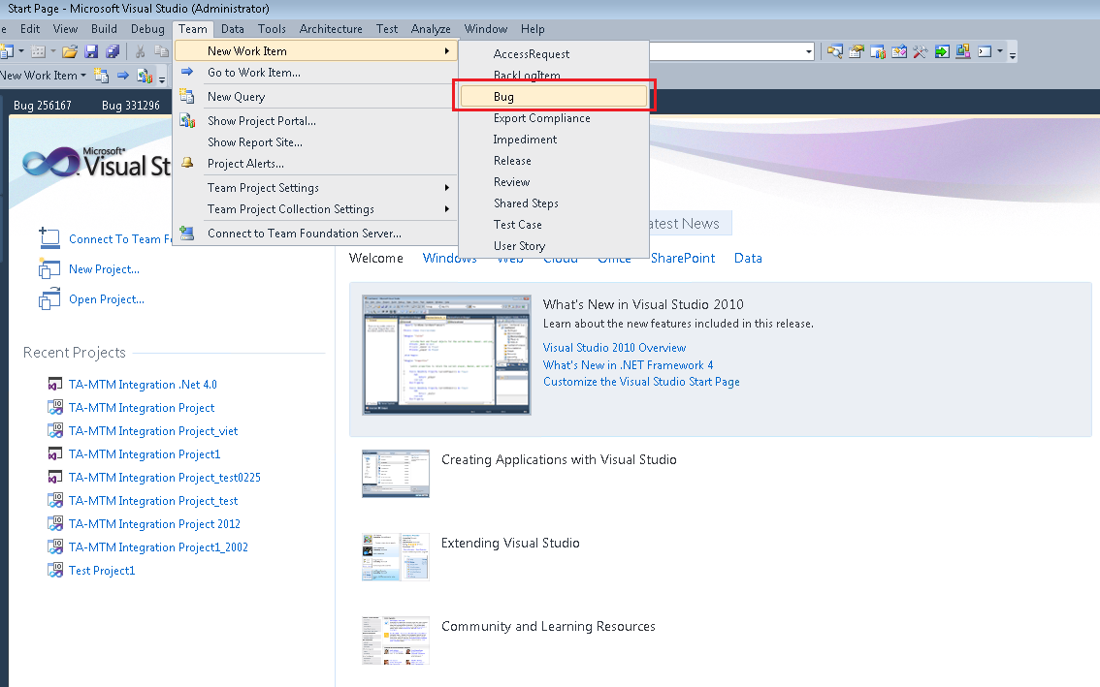
Steps to create a bug in TFS
Open Visual Studio and create a new work item

Slide 4
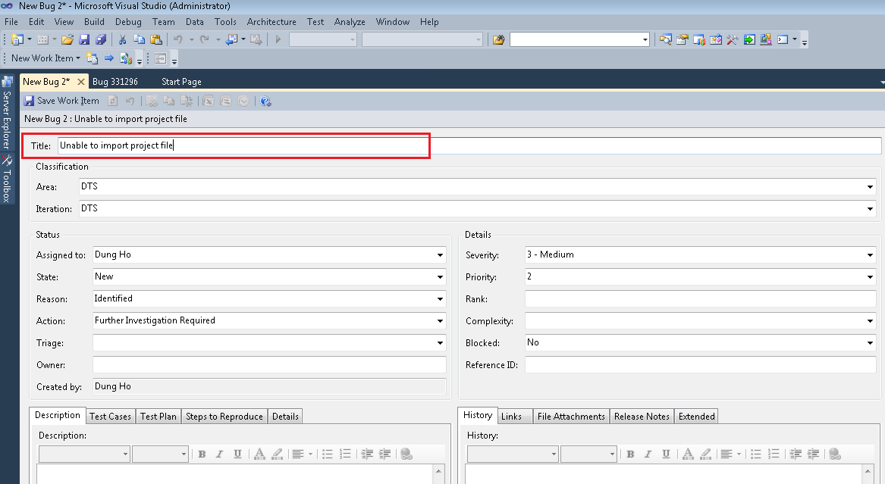
Steps to create a bug in TFS
Enter Bug Title

Slide 5
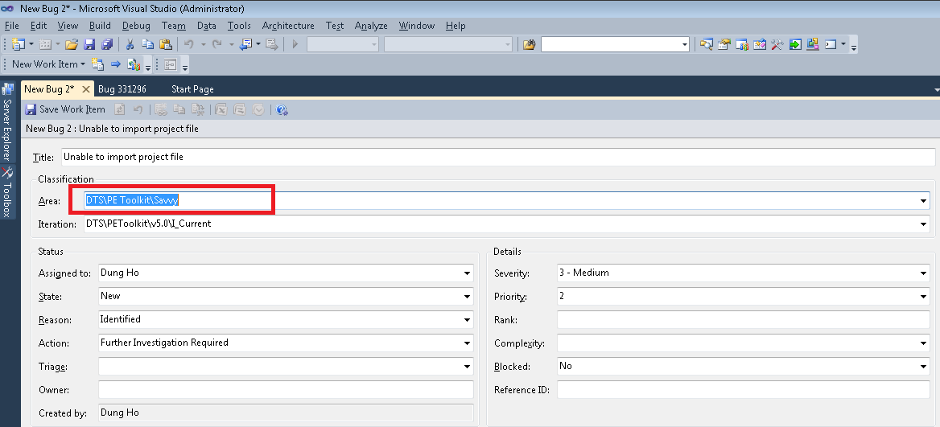
Steps to create a bug in TFS
Select the correct Area Path

Slide 6
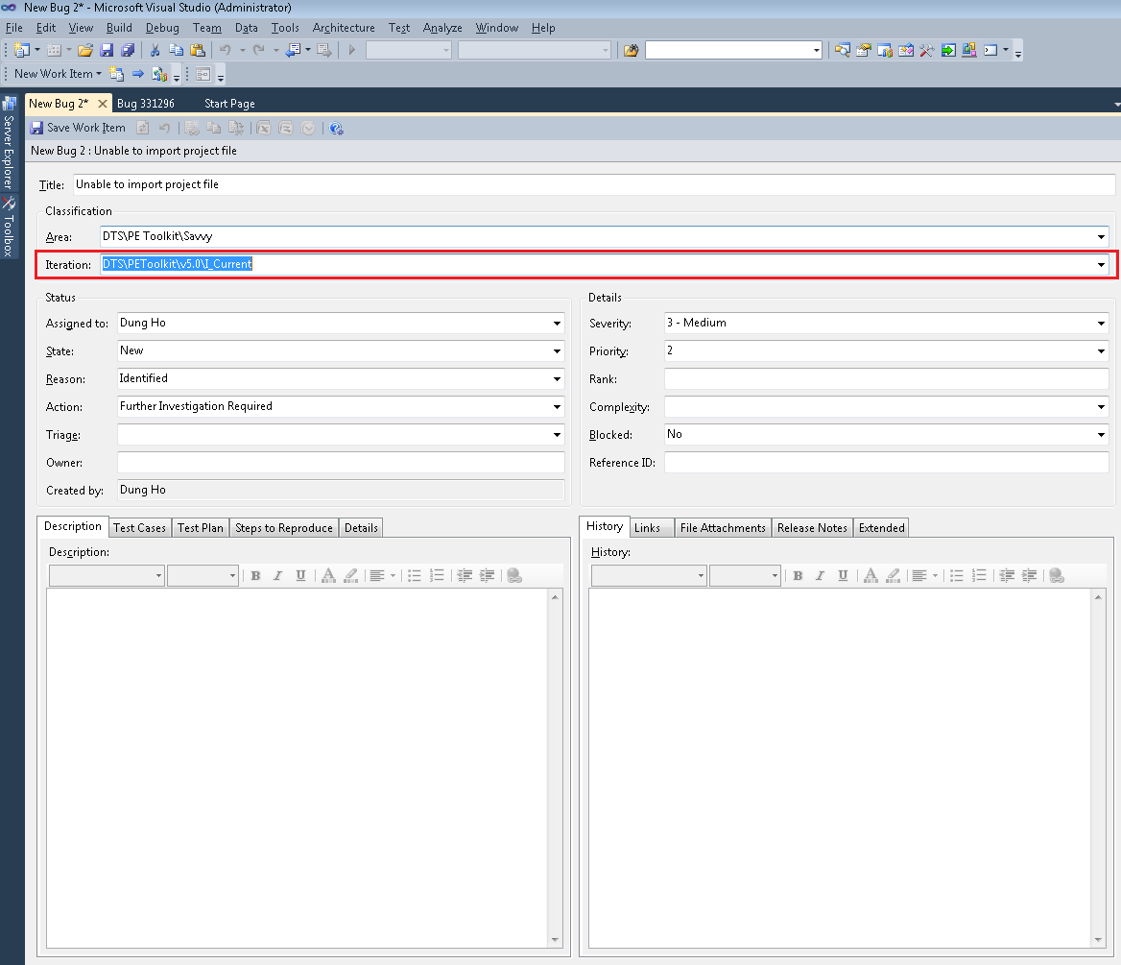
Steps to create a bug in TFS
Select current Iteration

Slide 7
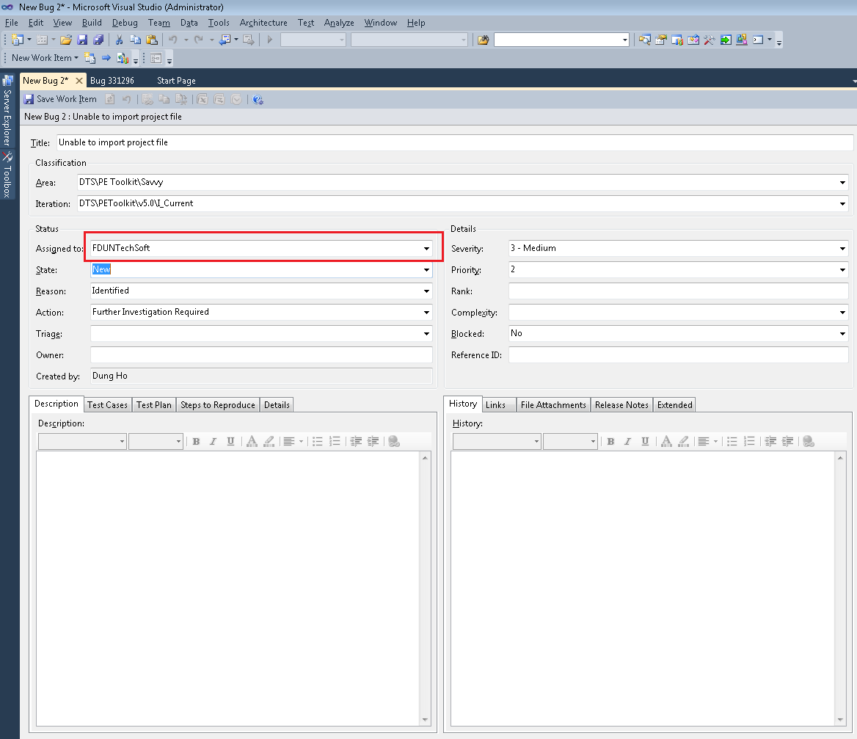
Steps to create a bug in TFS
Assign to Test Lead of Area or FDUNTechSoft user

Slide 8
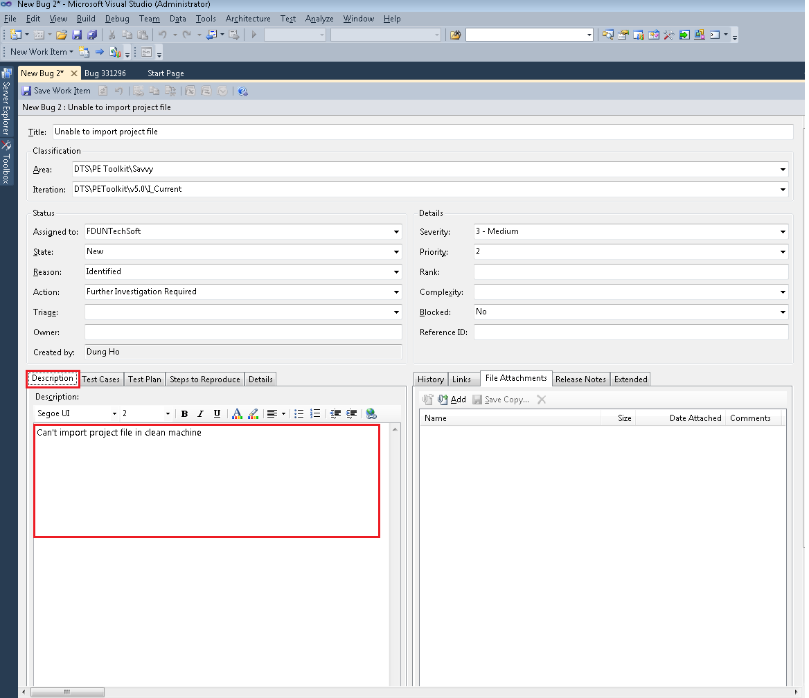
Steps to create a bug in TFS
Enter description

Slide 9
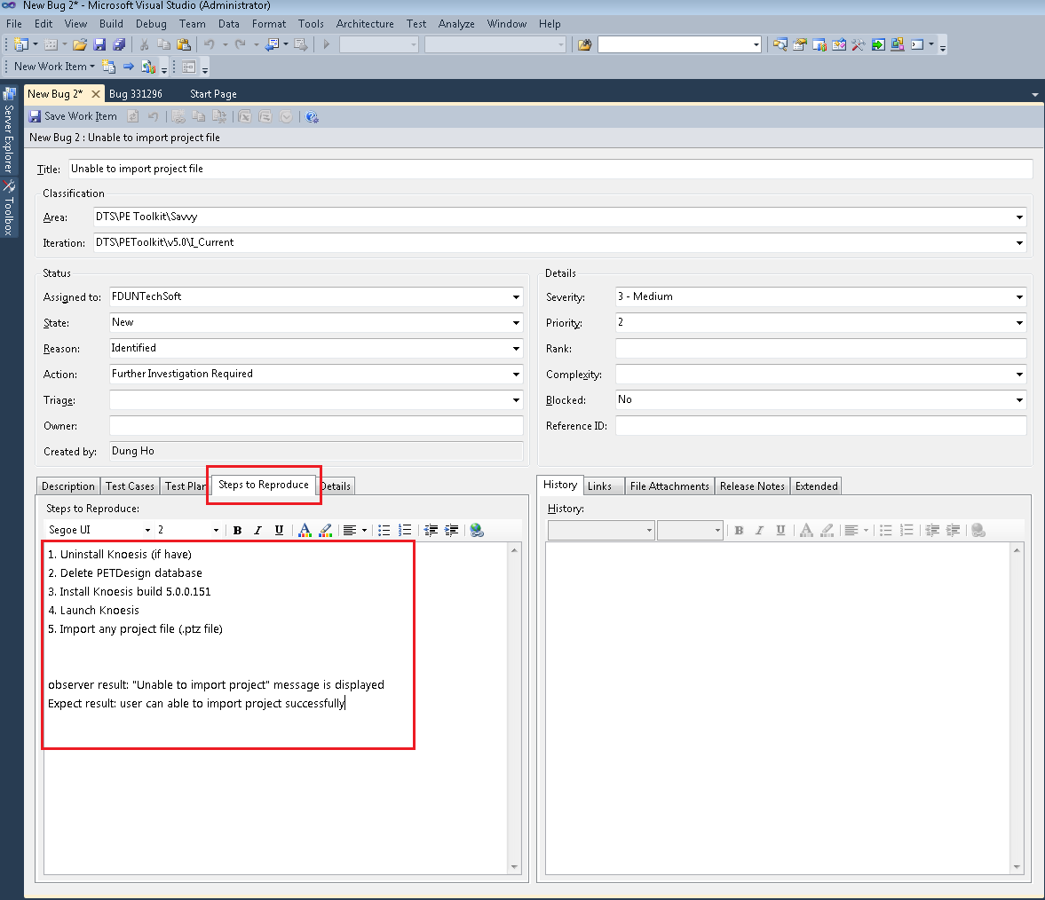
Steps to create a bug in TFS
Enter Step to reproduce

Slide 10
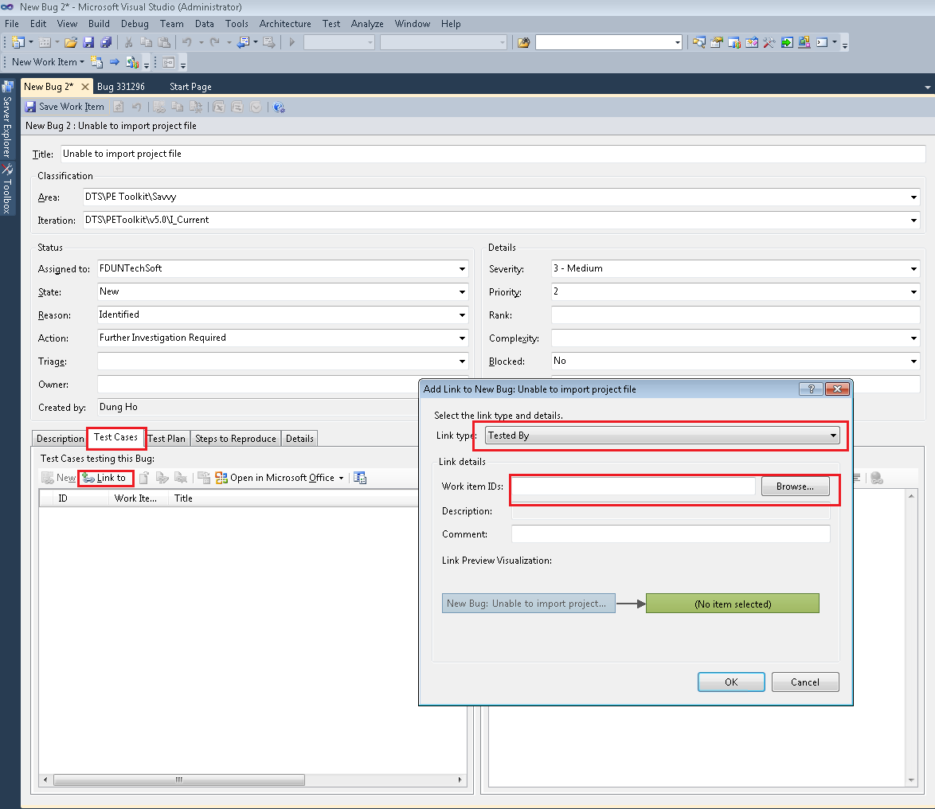
Steps to create a bug in TFS
Link to relate Test Case

Slide 11
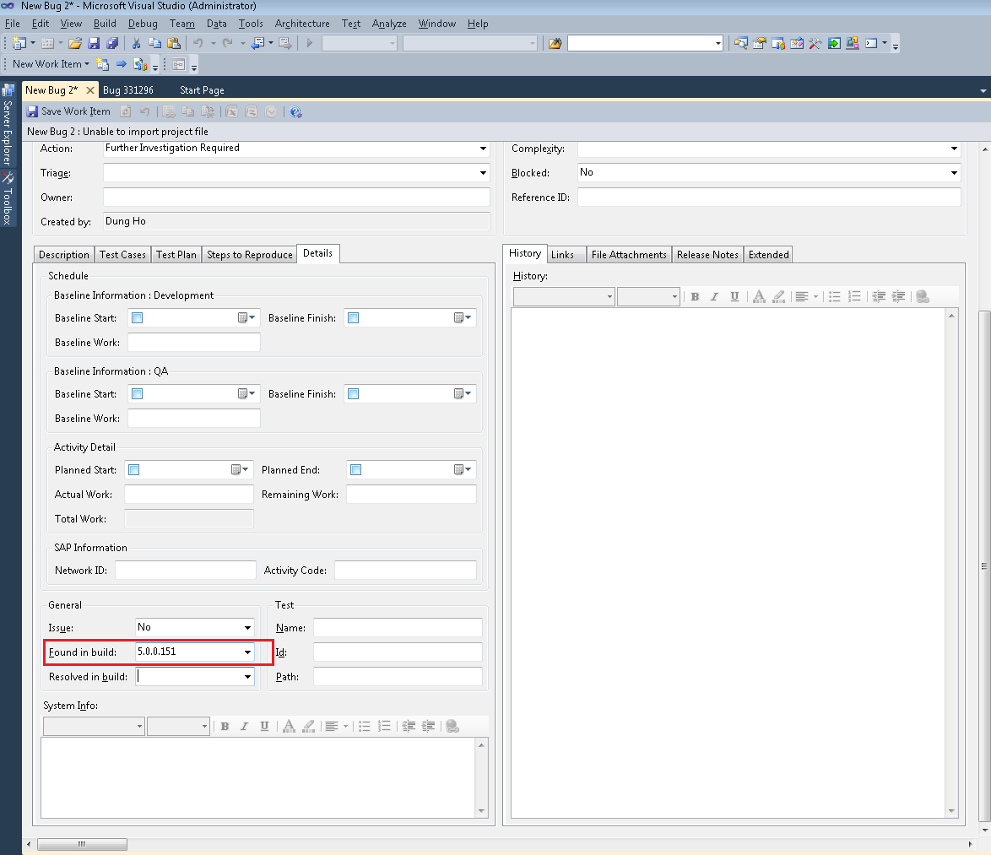
Steps to create a bug in TFS
Enter the build number we found the bug

Slide 12
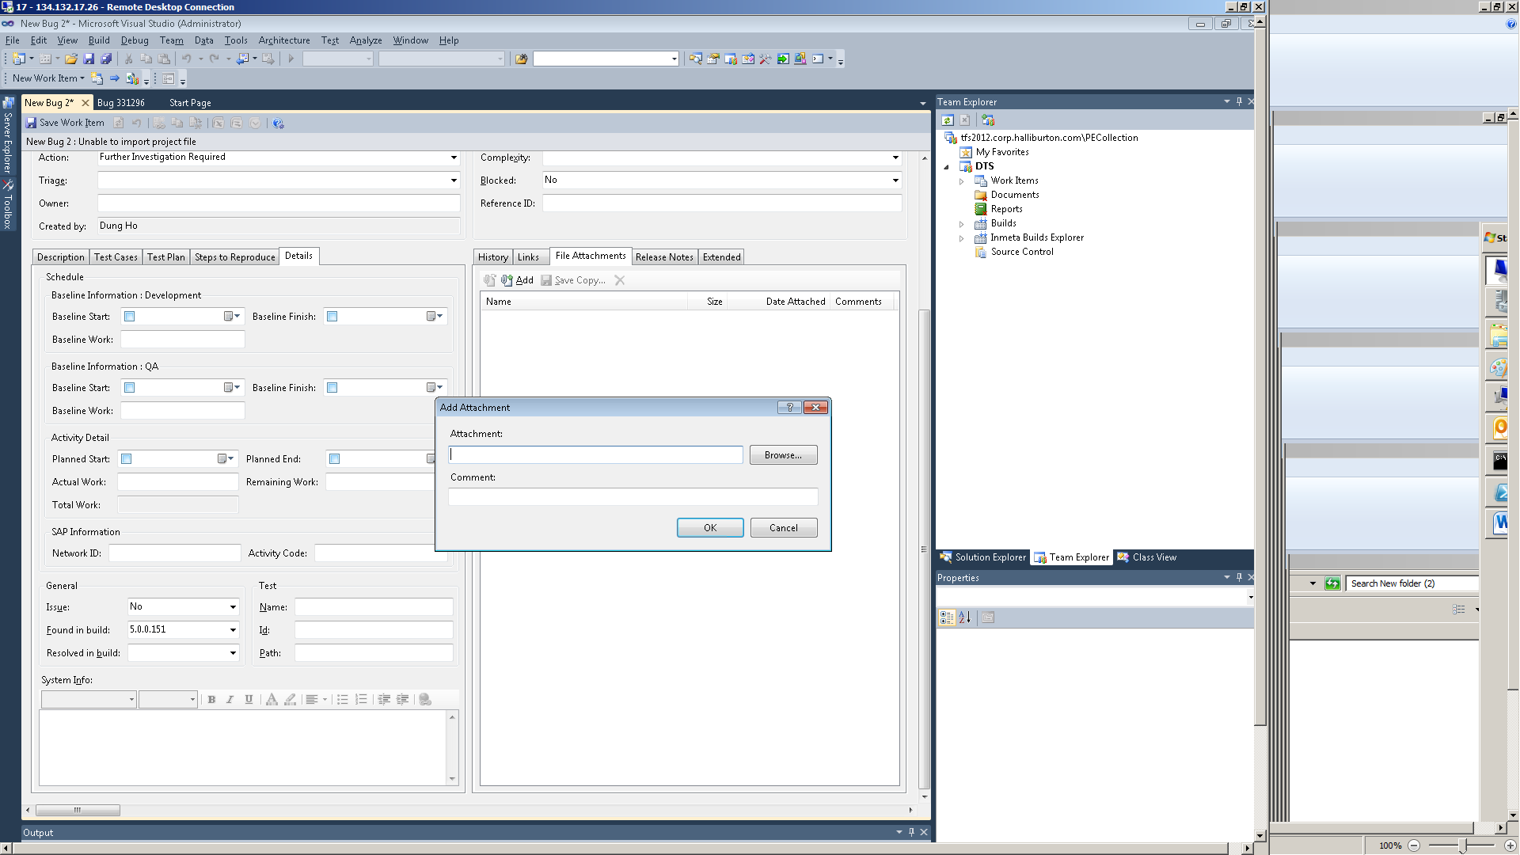
Steps to create a bug in TFS
Attach the bug image and log file of machine.

Slide 13
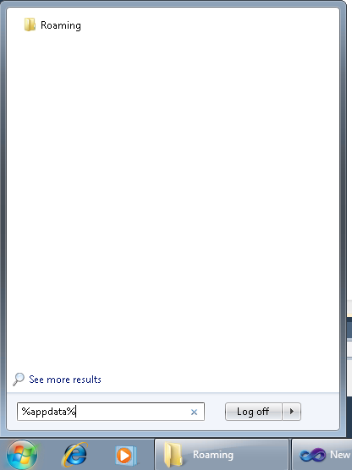
Step to get Knoesis log
C:\Users\”User”\AppData\Roaming.

Slide 14
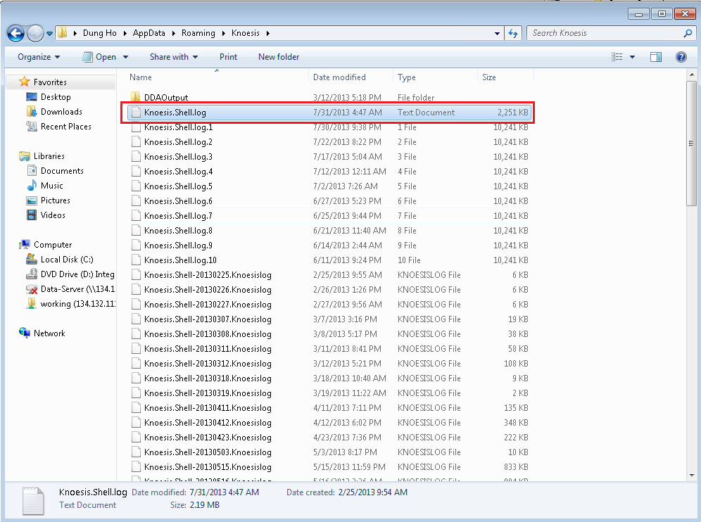
Step to get Knoesis log

Slide 15
Check list for a bug
Step | Checked
Bug Title
Correct Area Path
Correct Iteration
Assign to test lead or FDunTechsoft
Enter Bug description
Link to relate Test Case (If needed)
Enter Step to reproduce a bug
Enter Build which found the bug
Attach Image and Log file

Slide 16
The End
Thanks and regards

